Slide 1
Command {abstract}
Generate calendar
TaskList
+ execute() {abstract}
+ showUserMessage(String messages)
CalendarCommand
- daysInMonth: Integer
- totalDays: Integer
- totalWeeks: Integer
- startingDay: Integer
- month: Integer
Calendar
- checkMonth: Integer
- getStartingDay(): Integer
- getTotalWeeks(): Integer
- getTotalDays(): Integer
+ getMonthDetails(): Integer[]
+ setMonth(n: Integer)
+ execute( ):
- setNumber(n: Integer)
+ CaldendarCommand(month: Integer)
Check details
Search tasks
1
TaskList
Task
+ searchDate(n: Date): ArrayList<task>
- date: Date
*
+ getDate(): Date

Slide 2
CalendarCommand
:Calendar
tasks: TaskList
Ui:UI
execute()
getMonthDetails()
loop [weeks in month]
loop [days in week]
searchDate()
List of tasks
showUserMessage()
CommandResult

Slide 3
Common
Exceptions
UI
Calendar
Command
Main
Task
Parser
Storage
Local storage
*Arrow heads represent navigability of components
** Dashed body arrows represents being accessible by all components
Notes:
Main
UI
Storage
Parser
Command
Common
Tasklist
Task
Calendar
Exception

Slide 4
ExitCommand
Display result of command
CommandResult
User issued command
Main
{abstract}
Command
1
Send feedback for printing
Ui
showResultToUser(CommandResult)
Notes:
Main
UI
Storage
Parser
Command
Common
Tasklist
Task
Calendar
Exception

Slide 5
TaskList
1
Contains Task
*
{Abstract}
Task
~ title: String
~ description: String
~ reminder: String
~ category: String
~ time: ArrayList<LocalTime>
~ date: ArrayList<LocalDate>
~ location: ArrayList<String>
Class
TaskNonClass
Notes:
Main
UI
Storage
Parser
Command
Common
Tasklist
Task
Calendar
Exception

Slide 6
Command{abstract}
uses
UI
+execute(){abstract}
+showCategory(arr[string])
+showTask(arr[int])
ListCommand
AddCommmand
+ execute()
- getList (listTaskIndex : ArrayList<Integer>)
- getListByCategory (listTaskIndex : ArrayList<Integer>, category: String)
+execute()
1
1
TaskList
-categoryMap: Map(string, arr[int])
-tasks: ArrayList(Task)
+returnCategoryTask(category:String):arr[int]
+returnAllCategory():arr[string]
+getTask(taskIndex: Integer): Task
1
*
Task
category: string
+ getCategory():string
+ getTask():string

Slide 7
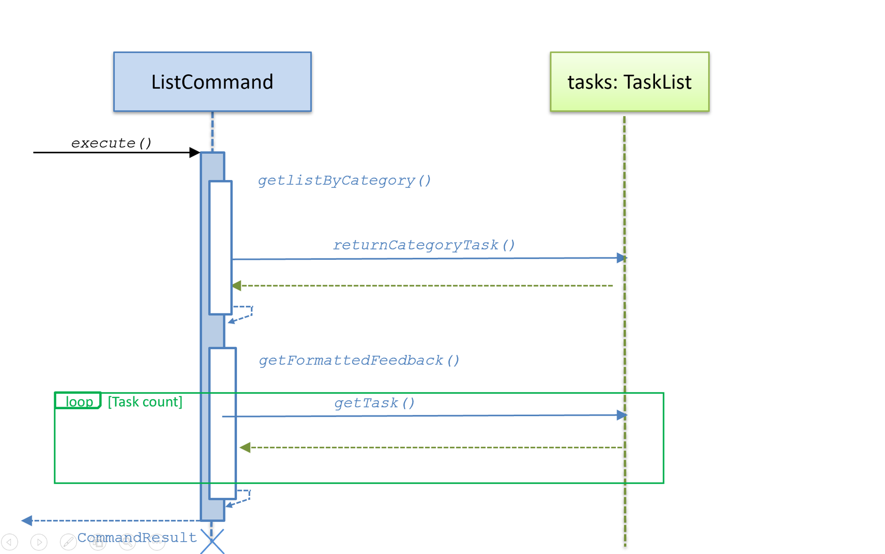

Slide 8
Class diagrams
Class name
attributes
methods
association
multiplicity of A
association label
role of B
Class A
Class B
role of A
multiplicity of B
Superclass
<<enumeration>> EnumerationName
inheritance
VALUE_1
VALUE_2
enumerations
Subclass 1
Subclass 2
composition
aggregation
Whole
Part
Container
Item

Slide 9
Class name
abstract/ static
visibility name : type multiplicity = default-value
{abstract} AbstractClass
visibility name (parameter-list) : return-type
classLevelAttribute
interfaces
abstractOperation {abstract}
classLevelOperation
<<interface>> Interface name
navigability
Class 1
Class 2
Class A
Class B
Association class
Class C
dependency
Class A
Class B
Class A
Class B

Slide 10
Class diagrams [example]
< adjacent to
3..8
neighbor
Minesweeper
0..1
Minefield
100
Cell
3..8
played on >
<<enumeration>> AdjacentMines
MinedCell
MineFreeCell
0,1,2,3,4,5,6,7,8
digit: AdjacentMines
1
Mine
Table
- number: Integer
- chairs: Chair [0..6] = null
+ totalTables: Integer
Customer
*
+ getNumber( ): Integer
+ setNumber(n: Integer)
+ getTotal( ): Integer
+ Table(n: Integer, p: Integer)
Reservation
LoyaltyProgram
- startTime
- endTime

Slide 11
Object diagrams
Object Name : Class Name
attributes
[example]
supervises
Jean:Student
Lee:Professor
name = “L. John”
Jon:Student
supervises
:Professor
:Student
:Admin
looked after by >
< looked after by

Slide 12
Sequence diagrams
alt [condition]
<<class>> :Logger
[condition]
name:Class1
[else]
class-level method
loop [condition]
create
:Class2
opt [condition]
self-call
message
return value
par

Slide 13
Sequence diagrams [example]
:TextUI
:MSLogic
<<class>> :Logger
Player
loop [until won|lost]
mark x y
markCellAt(x,y)
log()
getGameState()
Show updated minefield
gameState

Slide 14
Notes and constraints
Note text
{constraint}
Note text
{constraint}
[examples]
This association may change later
{total >= 0}

